Slide 1
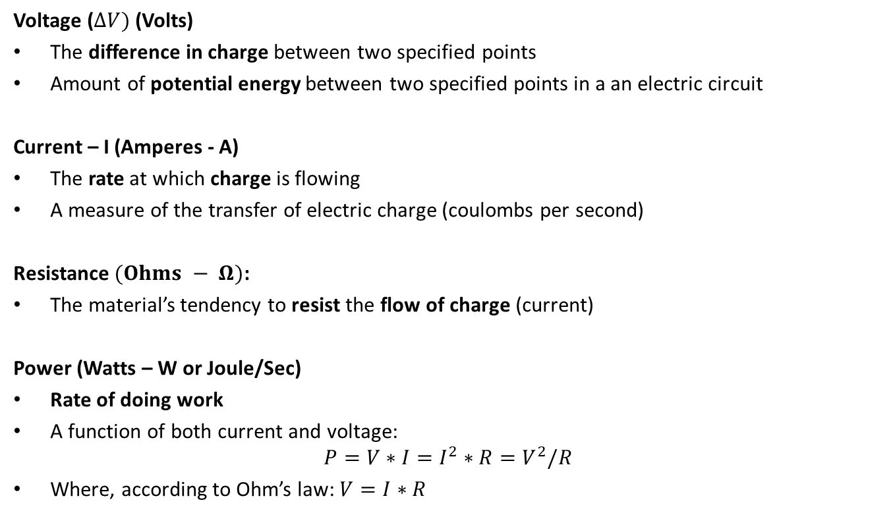
BASIC DEFINITIONS: VOLTAGE, CURRENT, RESISTANCE, POWER
Voltage ($∆V)$ (Volts)
The difference in charge between two specified points
Amount of potential energy between two specified points in a an electric circuit
Current – I (Amperes - A)
The rate at which charge is flowing
A measure of the transfer of electric charge (coulombs per second)
Resistance $(Ohms − Ω)$:
The material’s tendency to resist the flow of charge (current)
Power (Watts – W or Joule/Sec)
Rate of doing work
A function of both current and voltage:
$$P=V∗I=I^{2}∗R=V^{2}/R$$
Where, according to Ohm’s law: $V=I∗R$

Slide 2
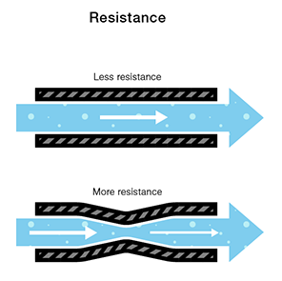
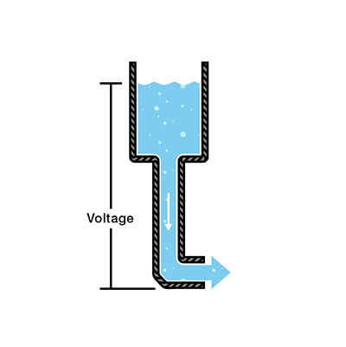
BASIC DEFINITIONS: WATER TANK ANALOGY
Water = Charge
Pressure = Voltage
Flow = Current
Hose Width = Resistance
More water in the tank means more pressure at the end of the hose
The battery is similar to the tank (Hydrodynamic Battery Model), stores a certain amount of charge and then releases it.
https://learn.sparkfun.com/tutorials/voltage-current-resistance-and-ohms-law

Slide 3
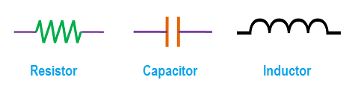
ELECTRICAL SYSTEM MODELING: BASIC ELEMENTS
Electrical systems consist of three basic electrical elements
Resistors (R)
Capacitors (C)
Inductors (L)
https://www.quora.com/A-resistance-opposes-the-current-in-a-circuit-but-a-reactance-also-oppose-the-current-in-a-circuit-What-is-the-difference-between-both

